Slide 1
Amadeus
Team 7
Ryuichi Ohhata, Dev Bhatia, James Wasson, Samantha Au, Brandon DeSiata

Slide 2
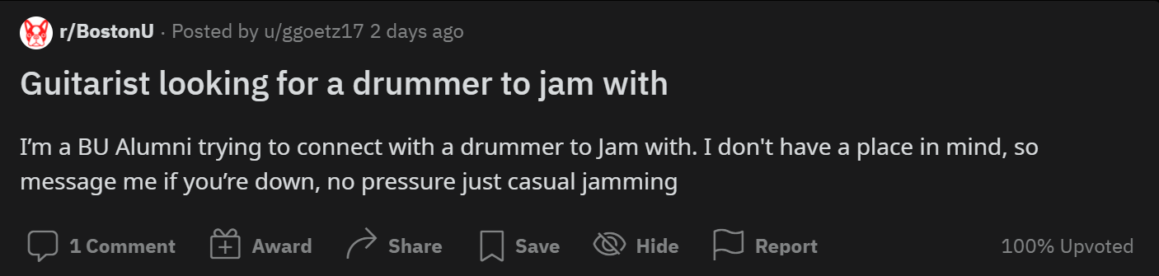
Motivation
Lack of people to play with
Lack of a venue to play in / attend

Slide 3
Solution - Core Services
Connect Local Musicians
Showcase Videos
Genre
Instrument
Skill Level
Location
Promote Shows
Bands + Individuals can enter details of local gigs
Specify genre / setlist
People can follow bands, receive notifications of their shows

Slide 4
Solution
01
Budding musicians first forming a band
User
02
Musicians looking to find venues and promote their shows
Buyer
03
Owners and operators of the local venues
Shareholder

Slide 5
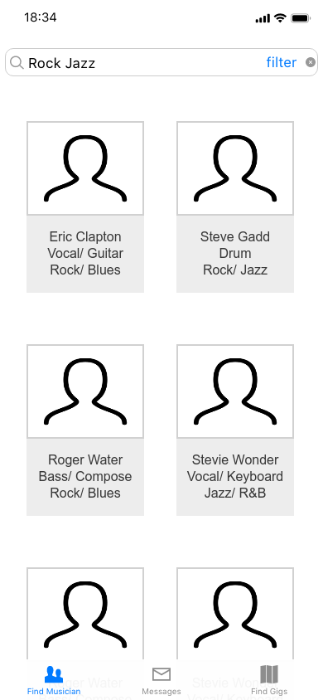
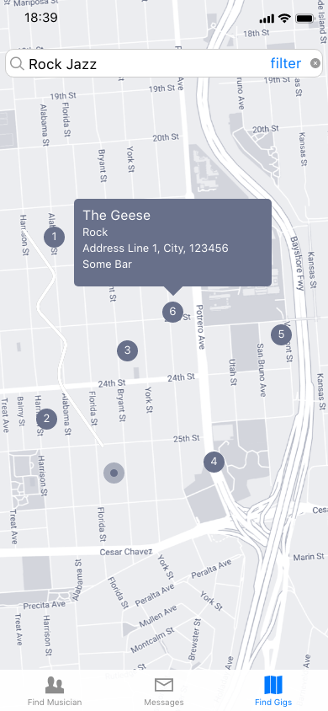
Visualization: UI
Find Musicians
Find Local Gigs

Slide 6
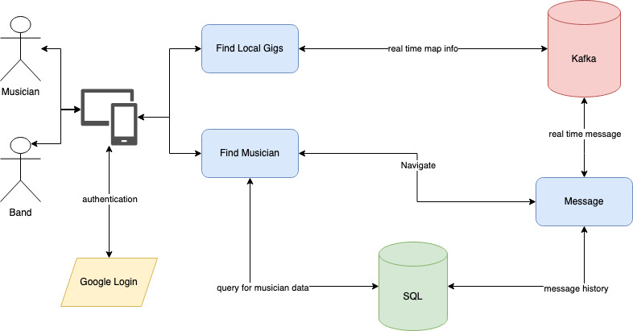
Visualization: Backend

Slide 7
Requirement
Reliable – data should be shared without any drop
Scalable – data should be shared at a large scale
Real time – data should be shared with the minimum latency

Slide 8
Competing Technologies
Key Competitors
Strengths
Weaknesses
1
MUZE
Excellent job of installing local (yet already established) musicians into weddings and corporate events
Offers nothing in the way of peer-to-peer connection, which is a service many have been clamoring for.
2
Instagram / Facebook
Scale of these platforms makes it easier to find people
Lack of focus causes many to be overwhelmed
3
Bandfriend
Likely the closest to what we would like to make, bandfriend introduced a connection mechanism for local musicians
Failed do anything more than just connect people, leading to massive user drop-off

Slide 9
Questions?

